Slide 1

BioRubeBot
CS452 – Senior Software Engineering Capstone Project
Spring 2018

Slide 2
About BioRubeBot
The project is sponsored by Dr. Cline of the biology department, and created by Athens State Students.
BioRubeBot is an educational sandbox simulator made with the purpose of teaching cellular biology to students.

Slide 3
About BioRubeBot Cont.
The purpose of the application is to make cellular biological concepts easier to approach and understand.
The application allows students to drag and drop proteins(game objects) into and outside of a cell, where those proteins will interact and simulate intracellular activities.

Slide 4
The Client’s Problem…
BioRubeBot needed to be ported to the latest version of Unity.
This port would update the game engine to the latest stable version of Unity
The client also asked that we assess and test the modular nature of the proteins in the game to evaluate the viability of implementing another level in the future.
Graphical: Fix GTP as it appears in the menu by removing the white circles that appear on the sprite.
Graphical: Change the menu so that it contains a GDP where it is needed.
Notes:
*******

Slide 5
Challenge to the team…
Initial troubles with Git/GitHub – getting the repo into a workable state
Having to learn a vast amount of information in a short period of time
Learning how Unity works from experimentation, and official documentation.
Becoming familiarized with relevant biological concepts, and processes.
Acclimating to working on a sizable pre-existing project spanning multiple versions over several semesters.
Before any game testing could take place all compiler errors had to be removed. This dictated to a great extent the work flow of the project.

Slide 6
Proposed solution
Update existing game files for use in the latest version of unity.
The Version of the game we inherited was 5.x
Latest Version of Unity is 2017.3.0
Fix menu graphical problems as time and porting allowed. Specifically those graphical problems that relate to the protein sprites in the scenes.
Assess the modularity of the project components for use in later development.

Slide 7
Details: Porting
Changed the Cross Platform Input Initialization script to reflect build targets that are current.
Removed the following build targets were removed due to obsolescence and compiler errors: BlackBerry, WP8, WebGL
WP8 was replaced with the current WSA(Windows Store Application)
The 2D animator controller had two broken pointer identifiers
- Solution: nullifying unnecessary processes by changing their PID’s
We cleaned up code that was left over from previous people that worked on the project. Much of this code was causing warnings.
Notes:
**************

Slide 8
Details: Graphical Changes & Modularity
Graphics: Changed the GTP in the menu to remove the white balls that were appearing on the sprite.
Modularity Assessment: Each protein in the game uses it’s own script to determine the moves it makes during game play. Thus, any protein as it currently exists could easily be reused in later levels of the project with the same functionality. Actions, and interactions are triggered based on the state of the tag attribute for each game object.
For example, the g-protein, when dropped onto the play space, has a tag that indicates it is connected to a GDP; after dropping the GDP the tag changes to reflect that it is no longer connected. That new state will then determine the actions that follow for the game object.
This means that additional behaviors could be added to the game objects by creating new, unique tags to trigger those behaviors, and those behaviors would work independently of pre-existing behaviors.

Slide 9
Results
The application builds and runs on current version of Unity.
The GTP appears in the menu as directed by Dr. Cline.
The application is at the point where implementing another level is a consideration.
Notes:
**

Slide 10
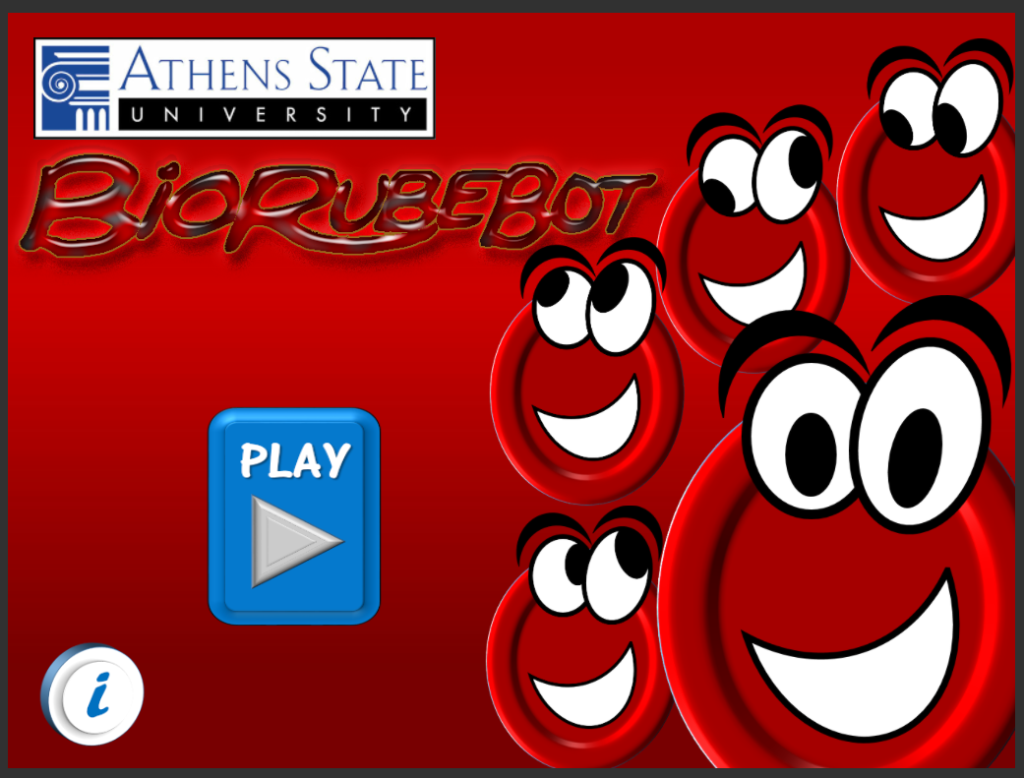
Demonstration

Slide 11
Conclusions
Game is ready to be deployed in place of older versions
Game is ready to tested by target audience(k-12)
Testing on this audience could provide feedback on the effectiveness of the application as an educational tool.
Finish Cleaning up some obsolete code that is still hanging around.
Make some fixes to prevent game sprites from getting stuck.
Potential Solution: Reference the game objects transform attribute per frame. If the delta of the transform is 0 after x number of frames, then manually modify the transform to push it back into motion.
Begin work on another level.

Slide 12

THANK YOU FOR YOUR TIME
Christopher Revelle & John Knowles

